Slide 1
Precipitation Potential Placement ER Flash Flood Workshop
Jeff Myers/Jim Noel
NOAA/NWS/OHRFC
James.Noel@noaa.gov
June 2-4, 2010

Slide 2
Precipitation Potential Placement History
NESDIS began using it to correct rainfall estimates in 1981 (Scofield)
OHRFC implemented it in 1996. Originally called precipitation efficiency.
NWA Digest Article Published in 2003.
Added to NWS AWIPS Supplemental parameters in 2008
Added to SPC meso-analysis page in 2008.
Ongoing research into combining moisture, instability and lift.
Notes:
QPFs are done twice daily at the OHRFC….00Z and 12Z for use in the National Weather Service River Forecast System (NWSRFS) as input to produce river forecasts out to 3 to 5 days. The addition of accurate QPF forecasting into the river forecast model allowed for additional lead time though the QPF had to be accurate not only in amounts but in the spatial and temporal distribution of the rainfall. The axis of heaviest rainfall was critical.
1996, OHRFC started using a “precipitation efficiency” parameter used by NESDIS as a correction factor for producing satellite precipitation estimates. The OHRFC adopted the parameter and integrated it into the meteorological models as a forecast parameter…Precipitation Potential.

Slide 3
Precipitation Potential Placement Parameter
Lower Tropospheric Relative Humidity (1000-700mb)
Precipitable Water (PW)
RH (1000-700mb) x PW

Slide 4
Precipitation Potential Placement Original Research
Percent occurrence of measurable rainfall for three different temperature environments

Slide 5
Precipitation Potential Placement Rules of Thumb for Onset of Rainfall
Onset for measurable rainfall is typically 0.3” to 0.6” during a cool environment (<37F)
Onset for measurable rainfall is typically 0.5” to 0.8” for a transitional temperature environment (37F – 69F)
Onset for measurable rainfall is typically 0.8” to 1.3” for a warm temperature environment (>=70F)

Slide 6
Precipitation Potential Placement Rules of Thumb for Axis of Heaviest Rainfall
Heaviest rainfall usually occurs along and to the left of the heaviest PPP axis in cold air advection scenarios.
Along and to the right of PPP axis in stationary and warm frontal set-ups. (Nashville example)

Slide 7
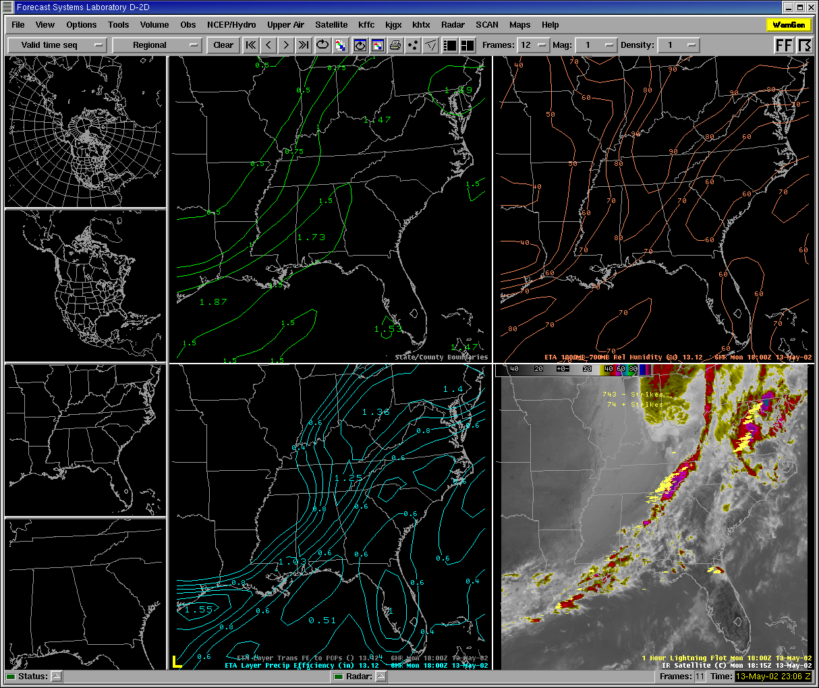
Precipitation Potential Placement
PPP improves over either PW or Mean RH
PW
PW
Mean RH
PPP
PE

Slide 8
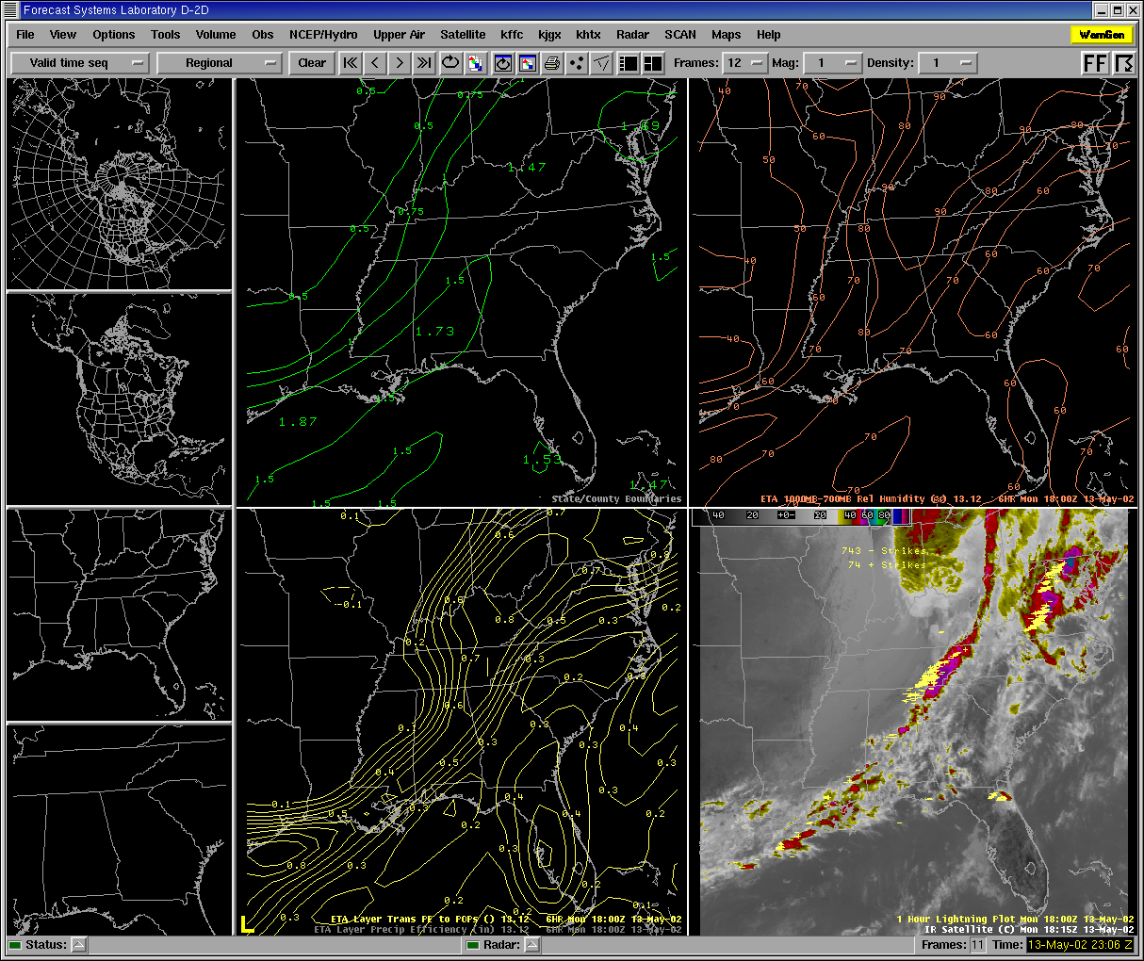
Precipitation Potential Placement
PPP can be converted to a 6-hour POP to assist forecasters based on the research data
PW
Mean RH
PPP to POP

Slide 9
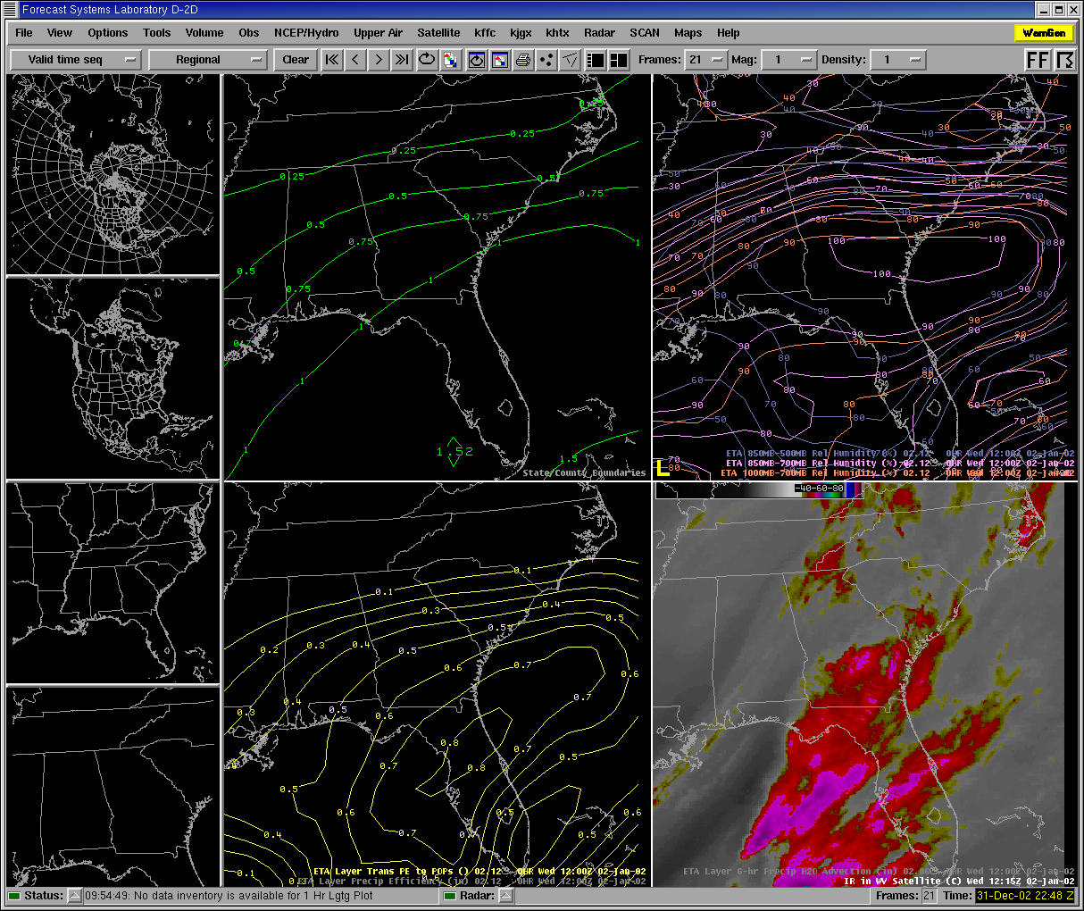
Precipitation Potential Placement
PPP helps to focus on placing the QPF better versus other broad spectrum parameters
PW
Mean RH
PPP to POP

Slide 10
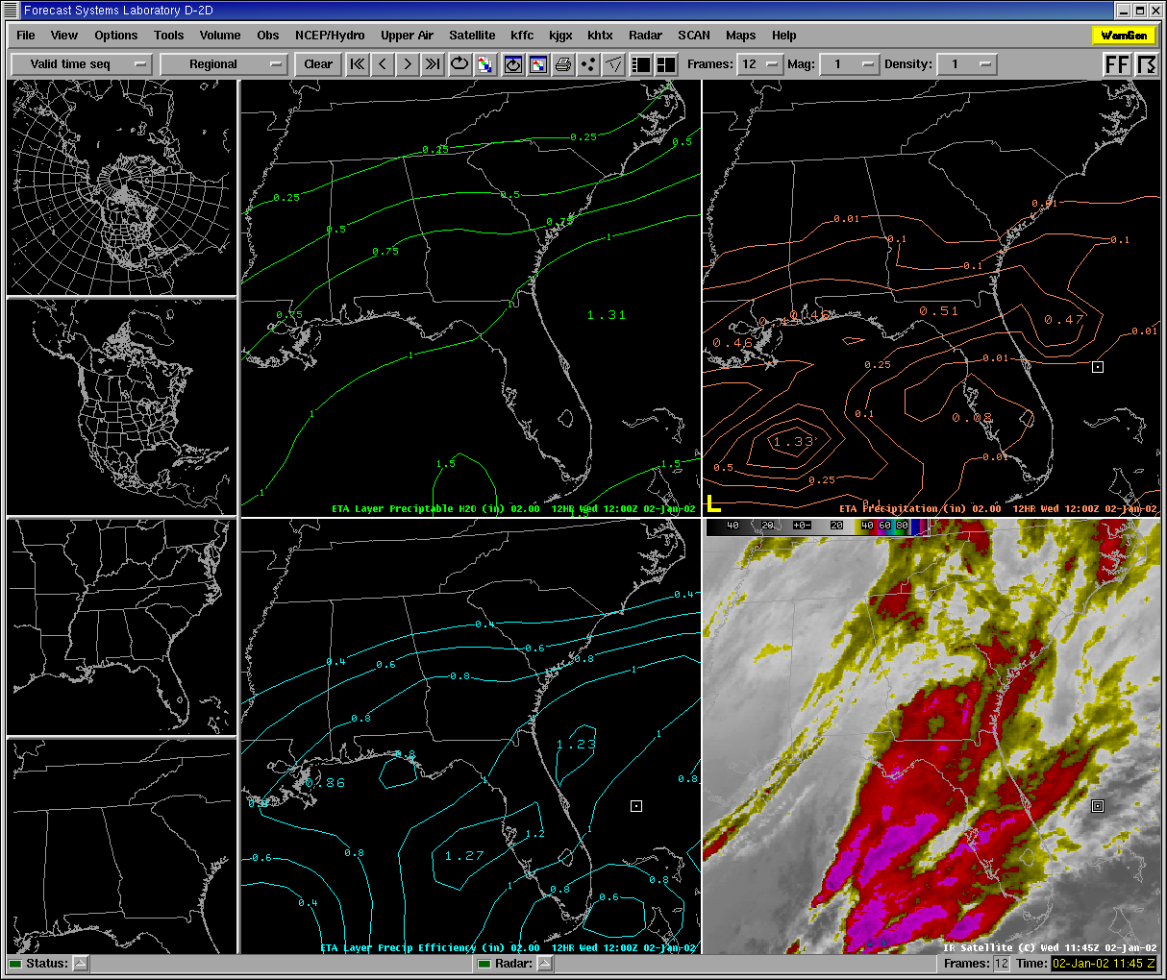
Precipitation Potential Placement
PPP helps to focus on placing the QPF better than model QPF in many cases
PW
Eta QPF
PPP
PE

Slide 11
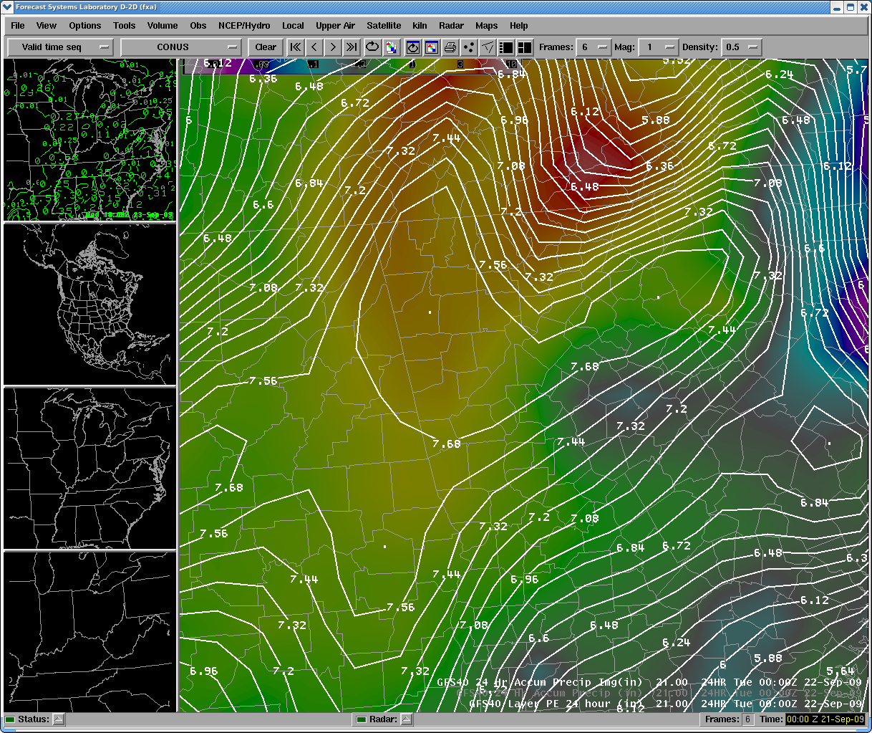
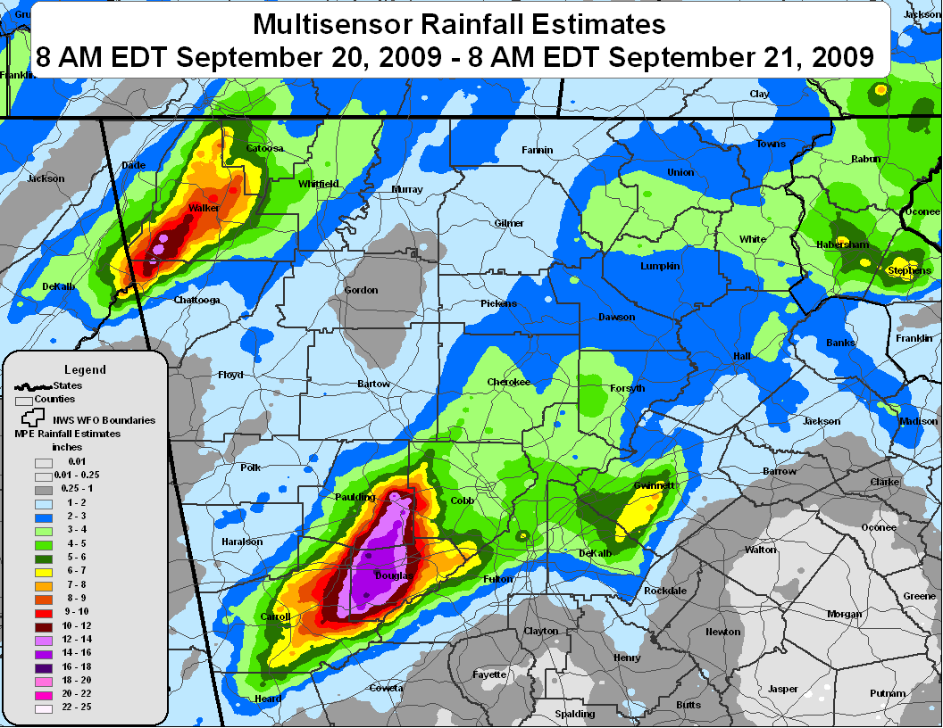
Precipitation Potential Placement
24-hr cumulative PPP compared better with observed rainfall versus 24-hr GFS QPF from Sep 20-21, 2009 flood event in GA
No ensemble QPF members handled this event
24-hr cumulative GFS PPP
24-hr MPE Totals

Slide 12
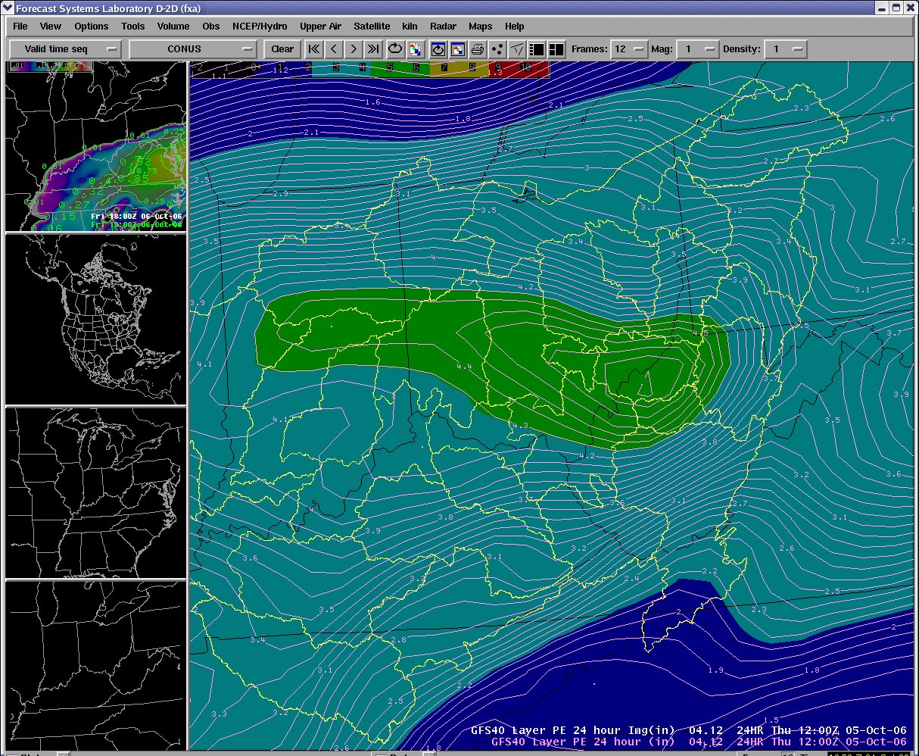
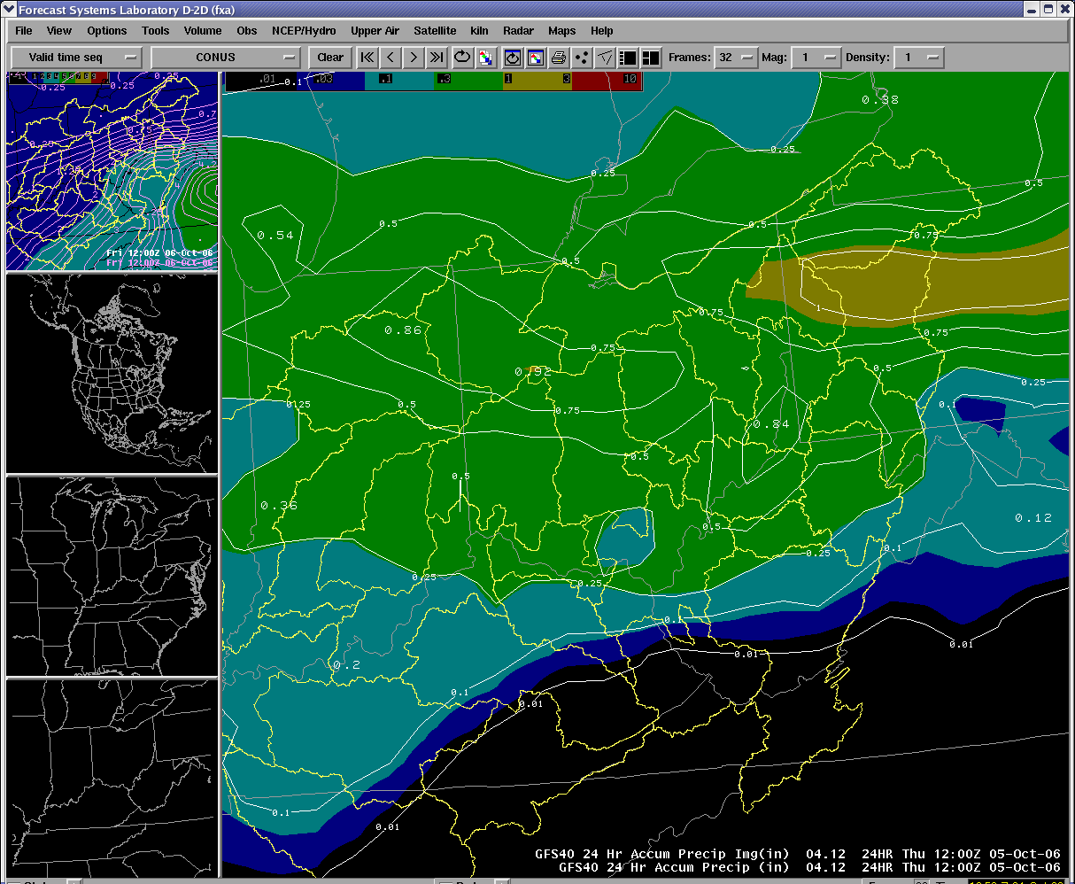
Precipitation Potential Placement
24-hr cumulative PPP compared better with observed rainfall versus 24-hr GFS QPF from Oct. 5, 2006 flood event in Ohio
24-hr cumulative GFS PPP
24-hr cumulative GFS QPF

Slide 13
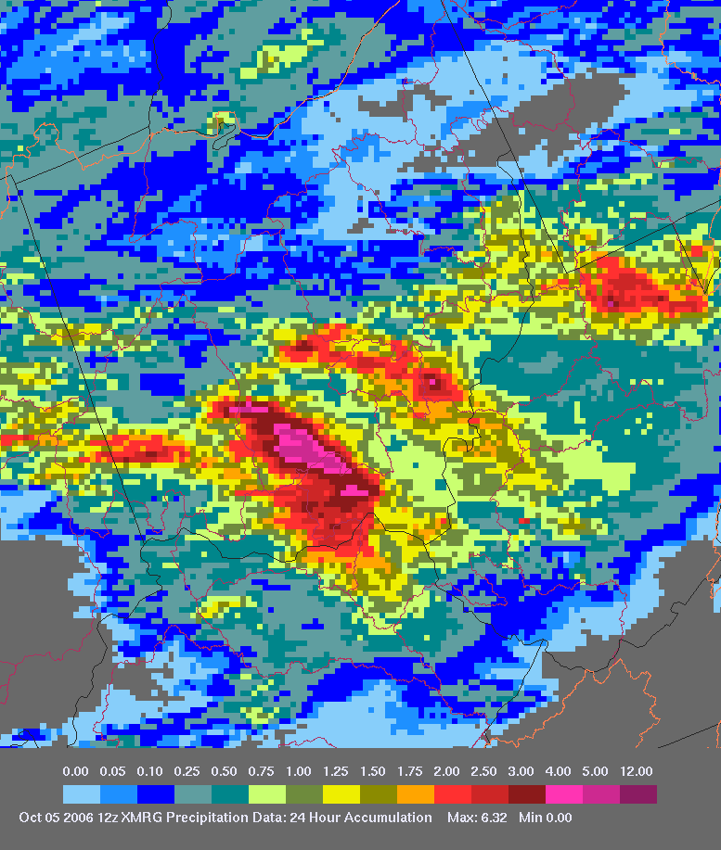
Precipitation Potential Placement
24-hr cumulative PPP compared better with observed rainfall versus 24-hr GFS QPF from Oct. 5, 2006 flood event in Ohio
24-hr cumulative GFS PPP
24-hr observed rainfall

Slide 14
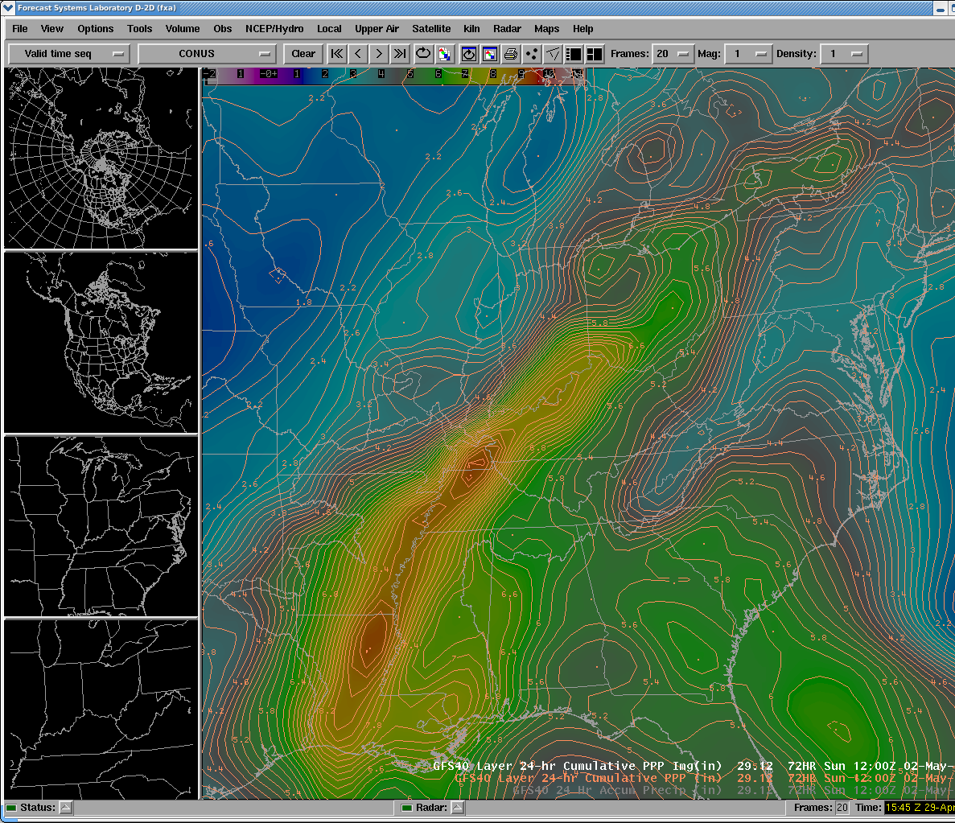
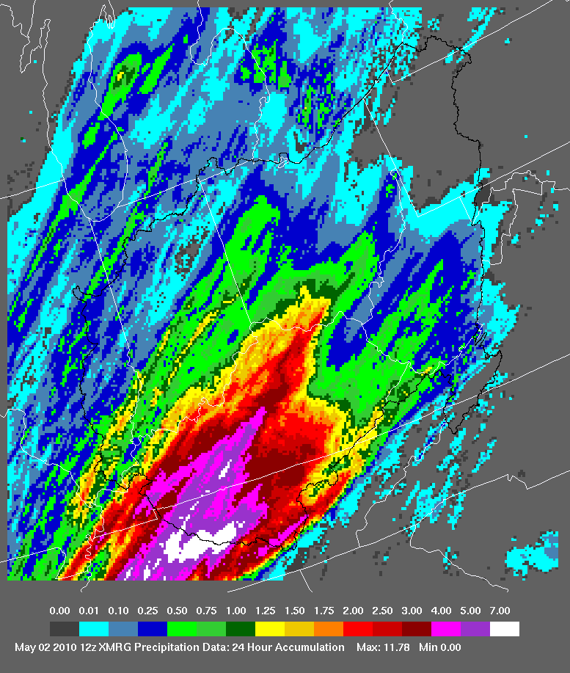
Precipitation Potential Placement
Historic Nashville Flooding Event
72 Hour PPP Forecast vs. Actual Rainfall

Slide 15
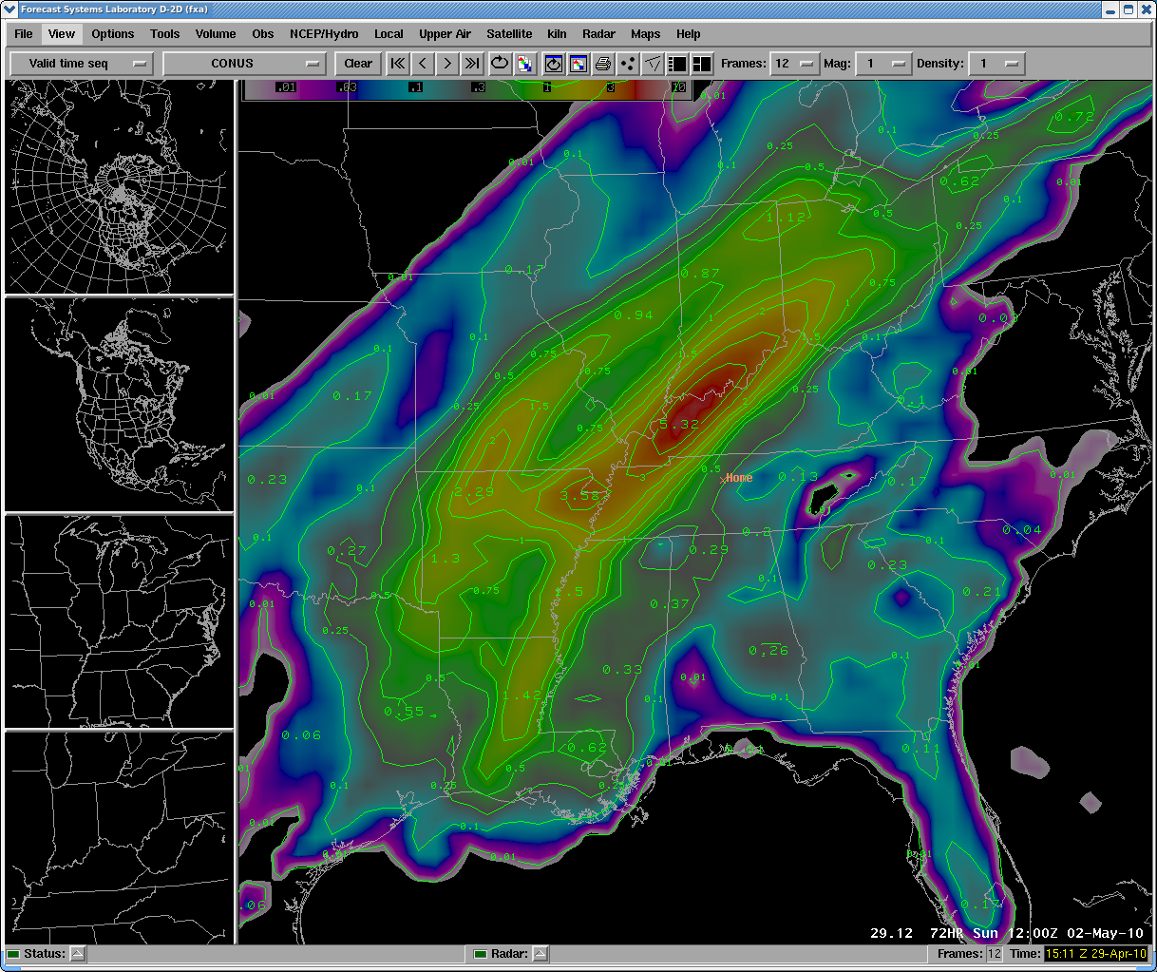
Precipitation Potential Placement
Historic Nashville Flooding Event
72 Hour GFS QPF vs. Actual Rainfall

Slide 16
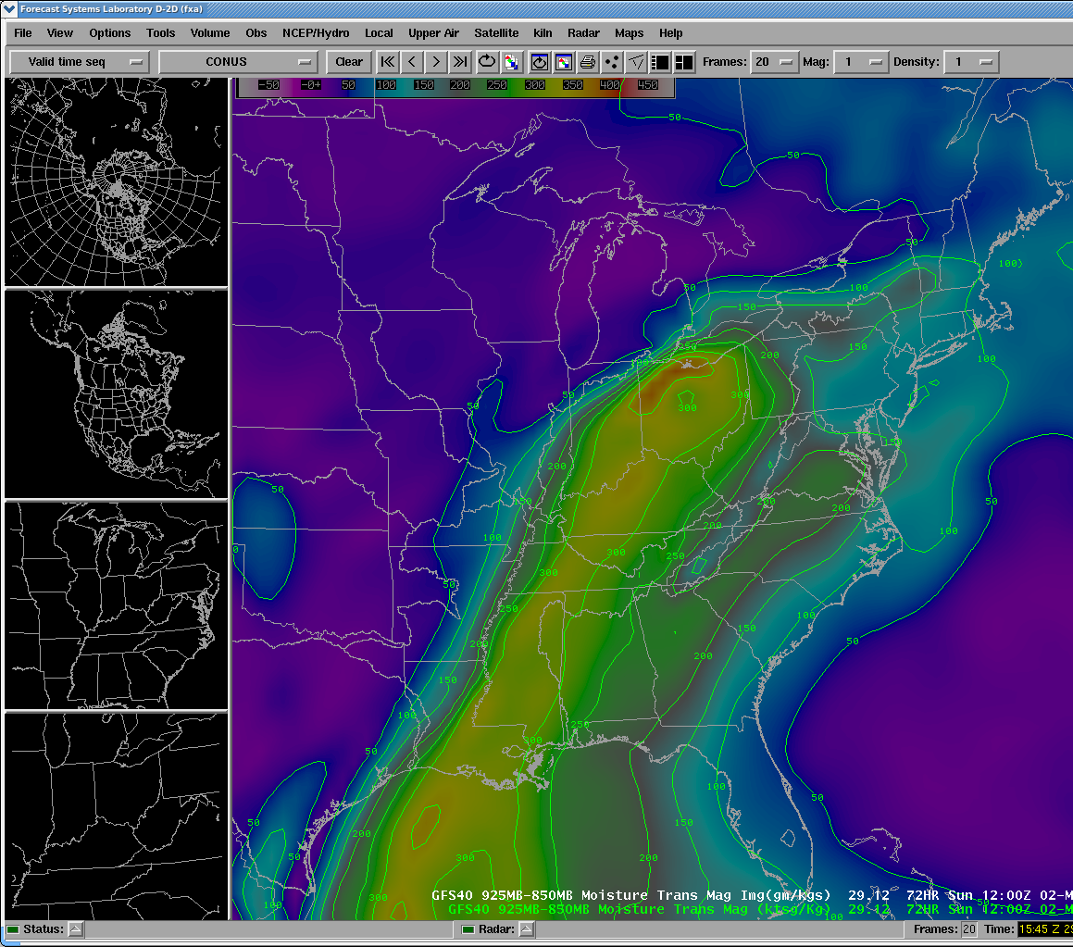
Precipitation Potential Placement
Historic Nashville Flooding Event
72 Hour Moisture Transport vs. Actual Rainfall
Notes:
Off topic of presentation, but Eularian Moisture Transport (Moisture Transport Magnitute in D2D) had axis even farther southeast where heaviest rain fell.

Slide 17
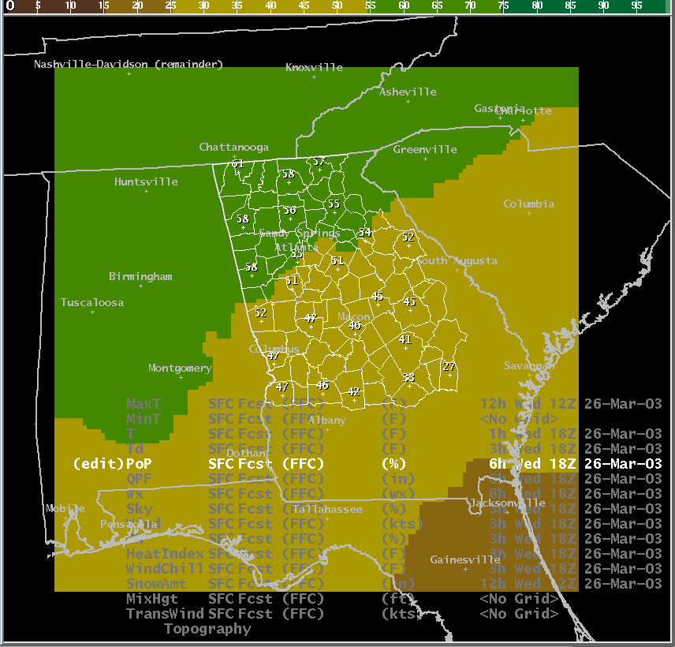
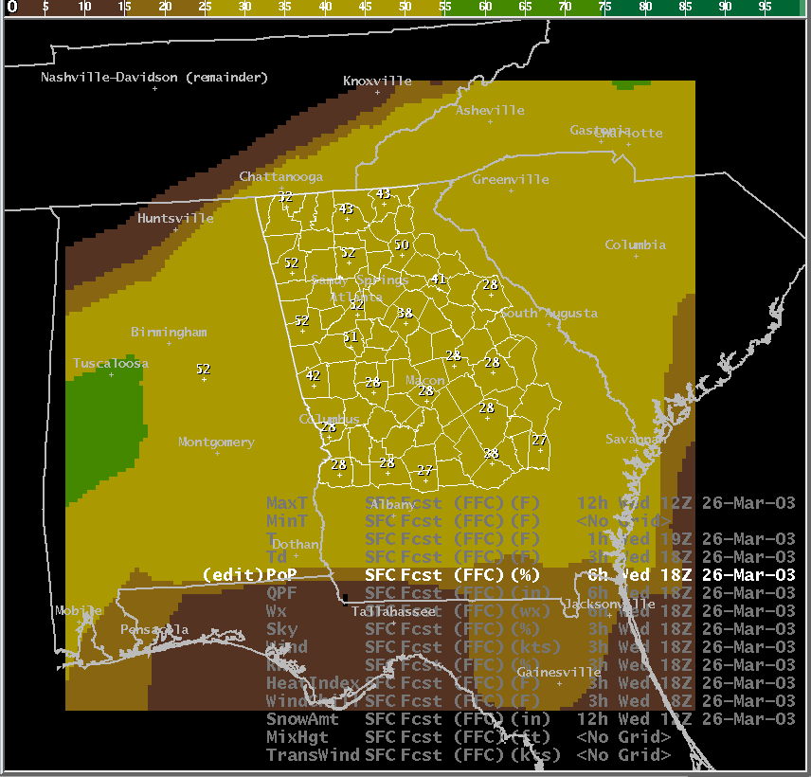
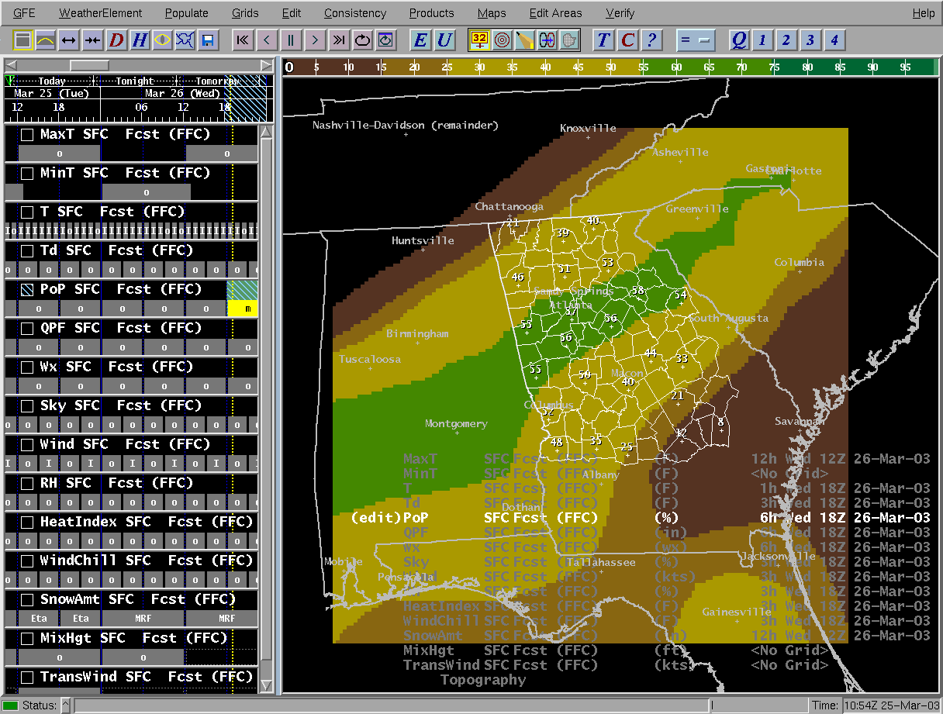
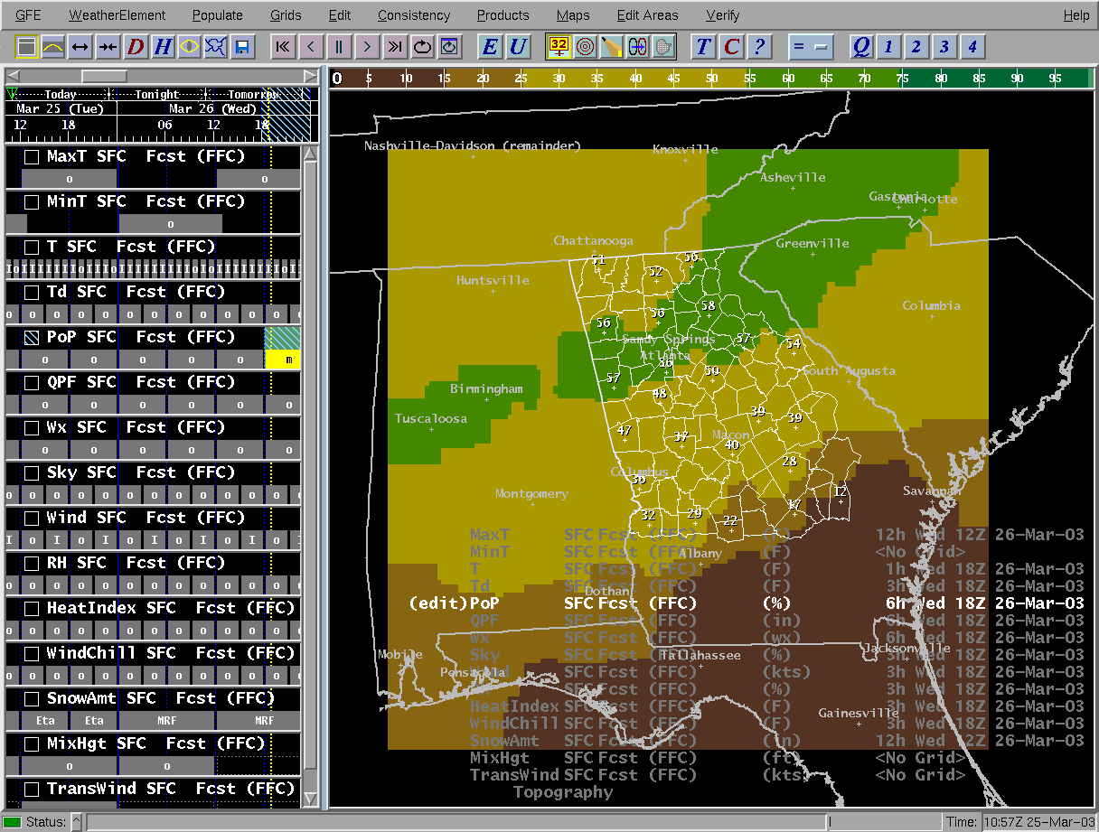
Precipitation Potential Placement
PPP can help with placement of rainfall
NGM MOS
GFS MOS
PE to POPs
Official NDFD Grid
16 Z
22 Z
Notes:
PE to POPs smart tool for GFE

Slide 18
Precipitation Potential Placement
PPP is designed to improve placement of rainfall but there is also a relationship to rainfall amounts

Slide 19
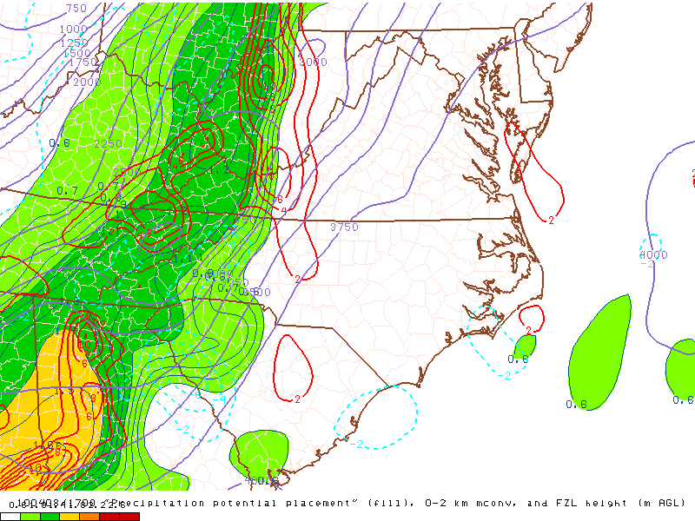
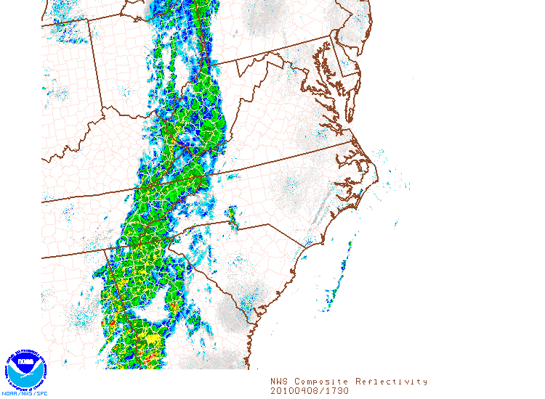
Precipitation Potential Placement
SPC added PPP to their real-time meso-analysis page in 2008
http://w1.spc.woc.noaa.gov/exper/mesoanalysis/

Slide 20
PPP Summary
PPP is not a silver bullet, however:
It is a good tool to assist forecasters in better placing QPF
It helps forecasters visualize rainfall placement and orientation with synoptic, MCS and tropical events
It should be used with other diagnostic and heavy rain forecasting tools
It is not designed to replace our movement into the ensemble and probabilistic world which is and will happen
It can assist modelers in identifying weaknesses in current QPF techniques
It does a good job in heavy rain events and convective events, but not isolated events
It does a decent job in MCS events

Slide 21
Precipitation Potential Placement Research
Current research is focusing on combining of the big three: moisture, instability and lift (maximizing PPP)
Current research shows moisture and lift dominate of the three
By combining the three, placement improves further
Preliminary results of 44 events
GFS PPP POD 0.61 and FAR 0.55 for heavy rain occurring in the max bulleyes
GFS PPP POD 0.98 FAR 0.14 for maximum rain axis occurring in the maximum bulleyes or along the gradient around bulls-eye
MM5 PPP POD 0.62 and FAR 0.45 for heavy rain occurring in the max bulleyes
MM5 PPP POD 0.97 FAR 0.25 for maximum rain axis occurring in the maximum bulleyes or along the gradient around bulls-eye

Slide 22
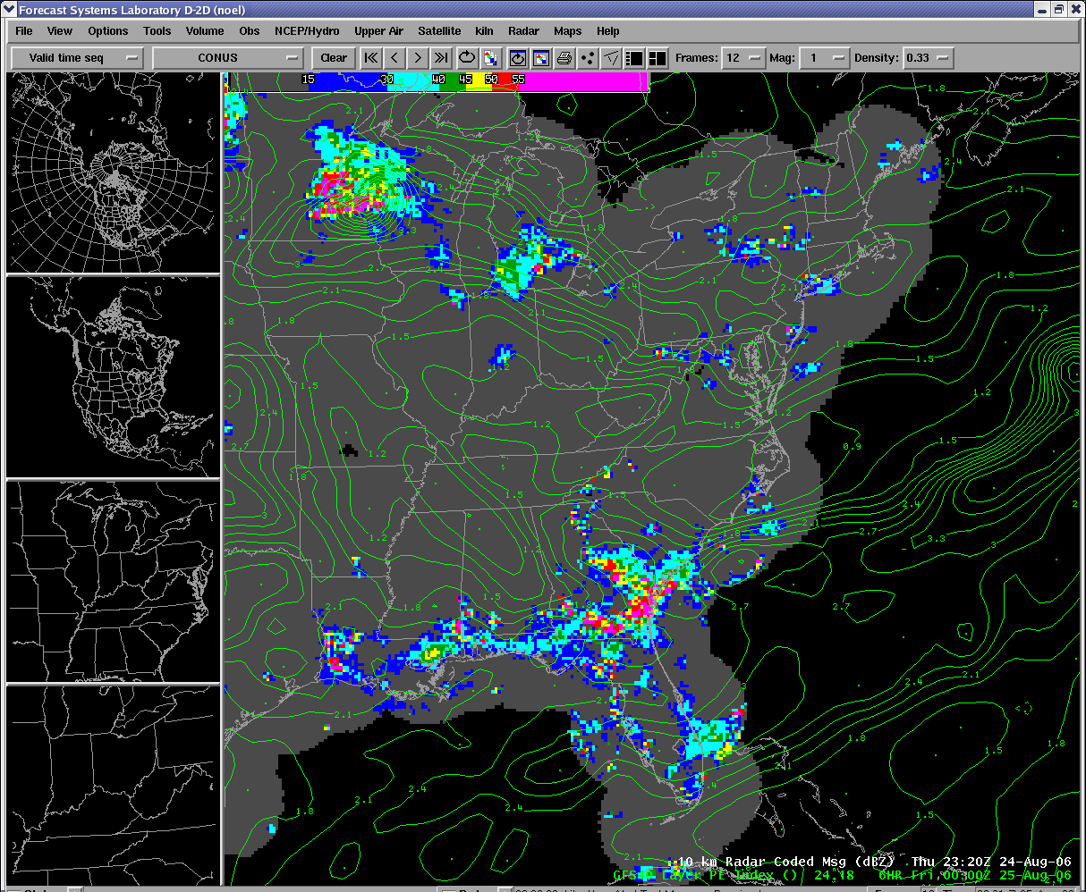
Precipitation Potential Placement Research
Example of maximizing PPP using low level convergence and PPP for MCS moving from MSP to DTW

Slide 23
Precipitation Potential Placement
More information:
Look for NWA Digest Publication Volume 26 Numbers 3,4
Questions or Suggestions:
Jeffrey.Myers@noaa.gov
or
James.Noel@noaa.gov

